Slide 1
What are the optimal parameters for alignment and differential expression analysis?

Slide 2
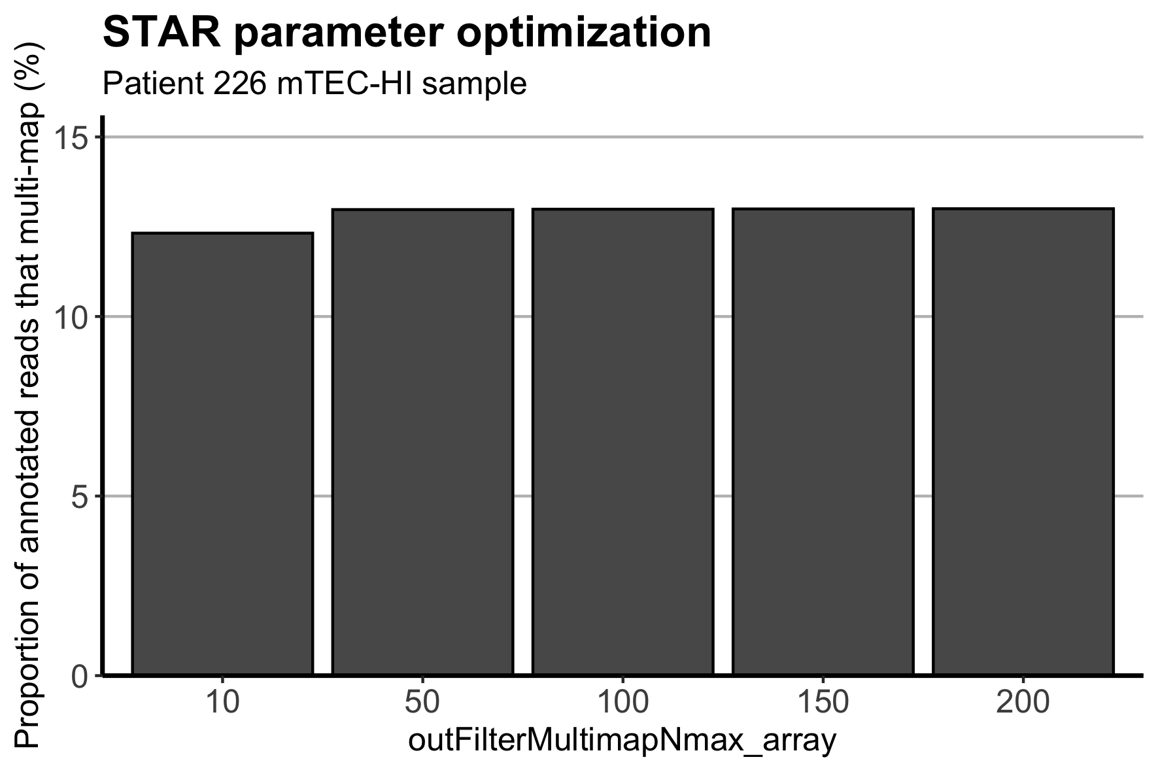

Slide 3
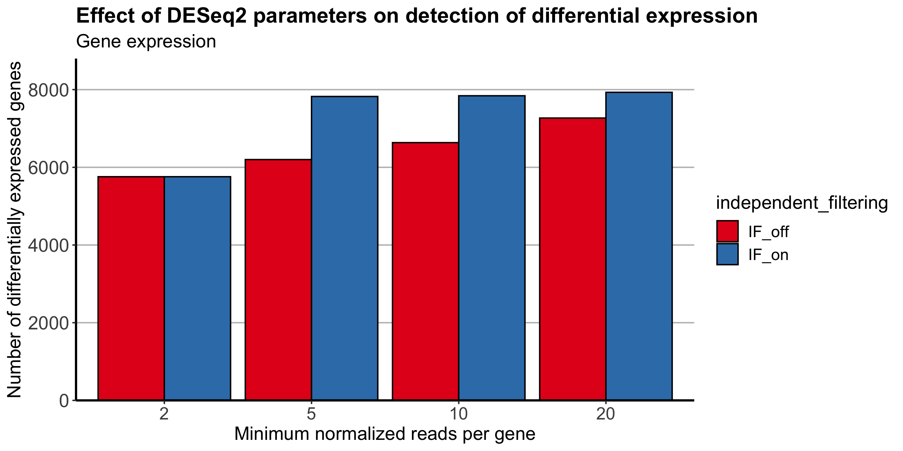

Slide 4
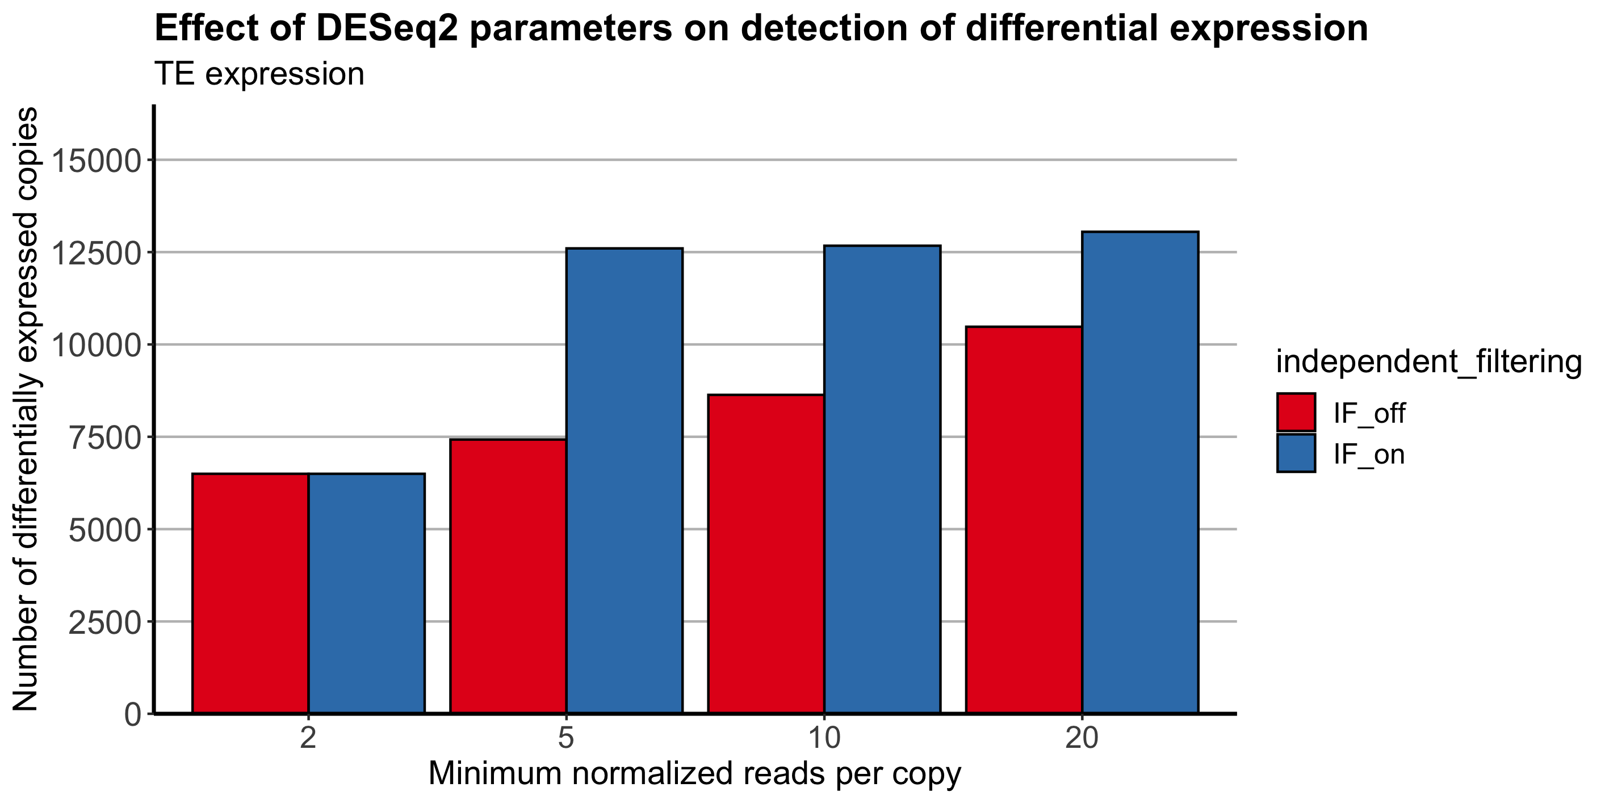

Slide 5
Is TEtranscripts biased against elements that show heterogenous changes in expression at the locus-level?

Slide 6
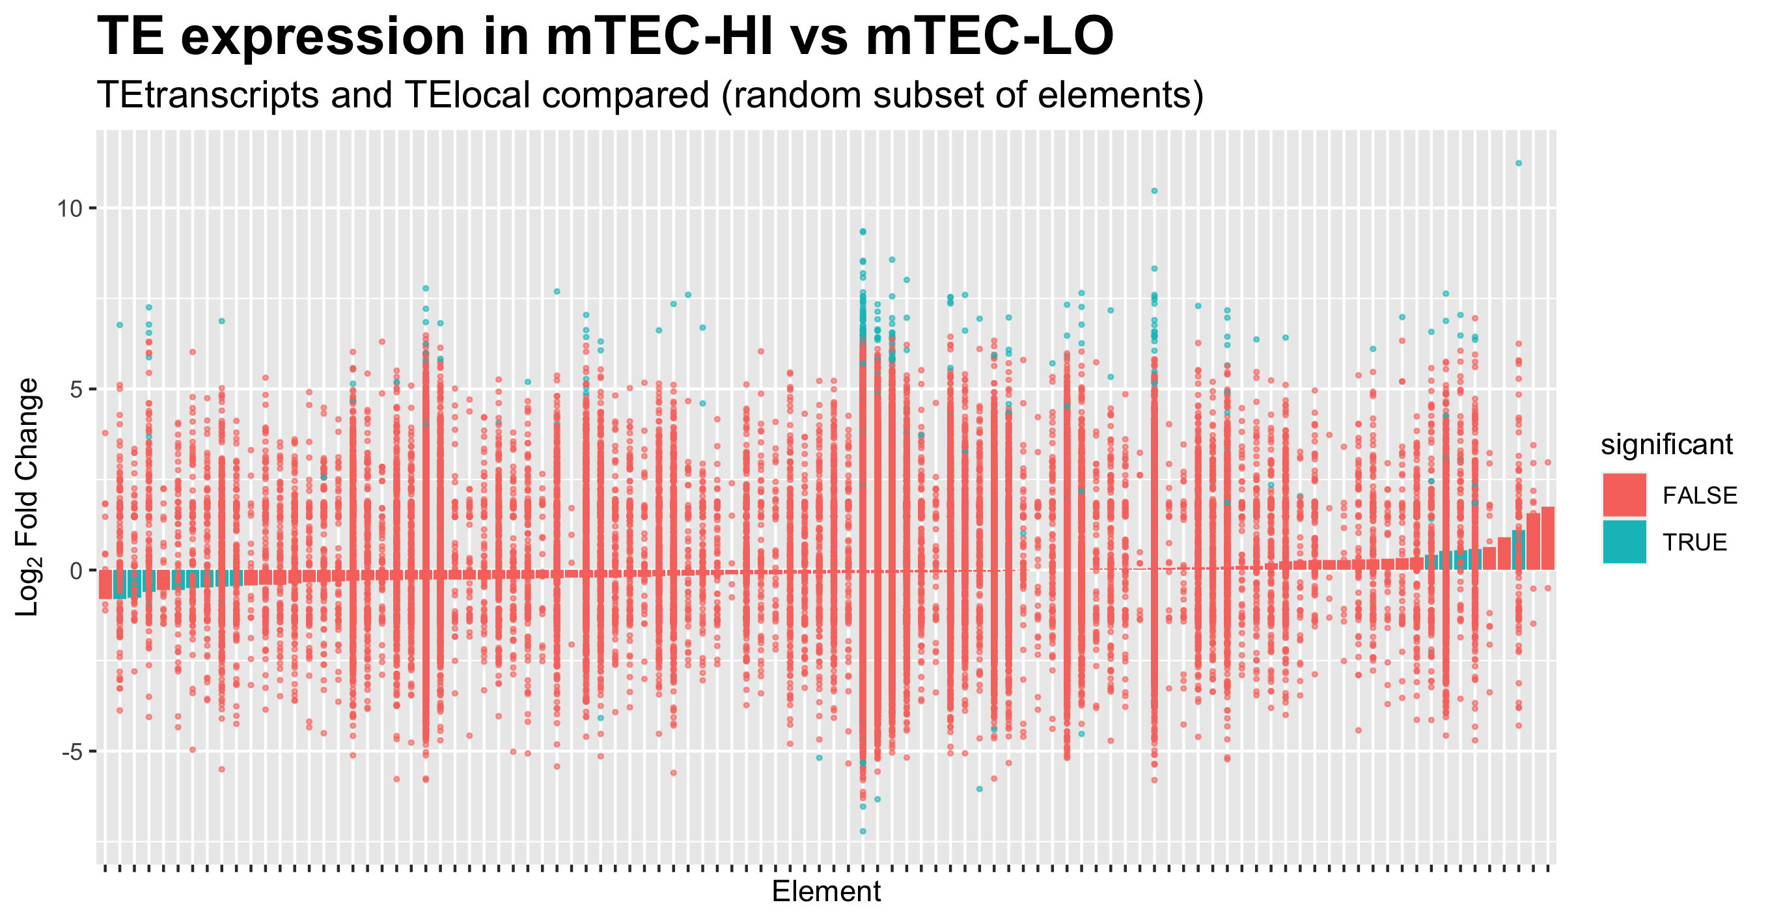

Slide 7
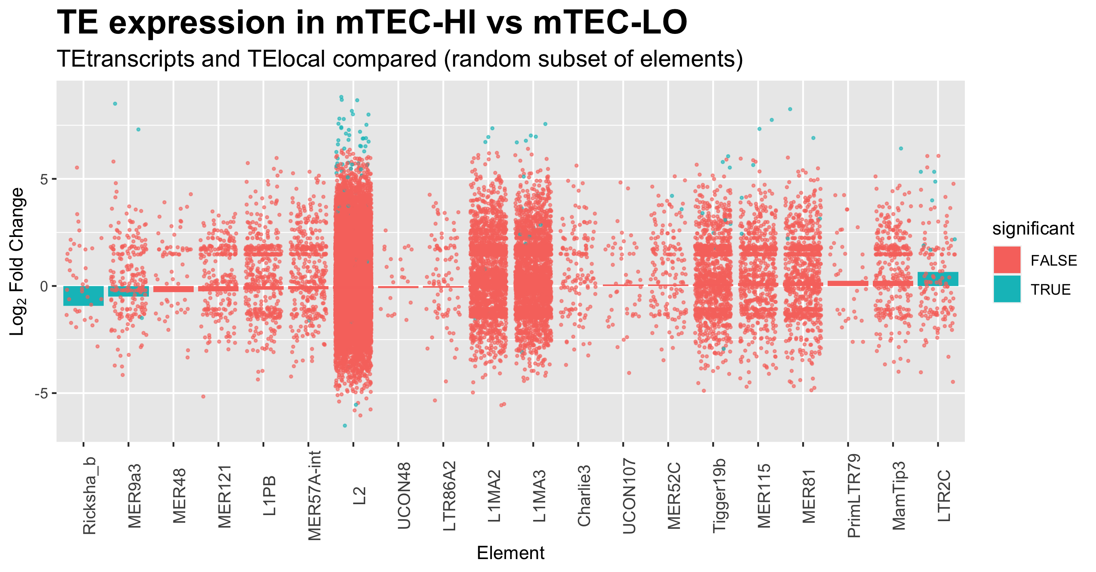

Slide 8
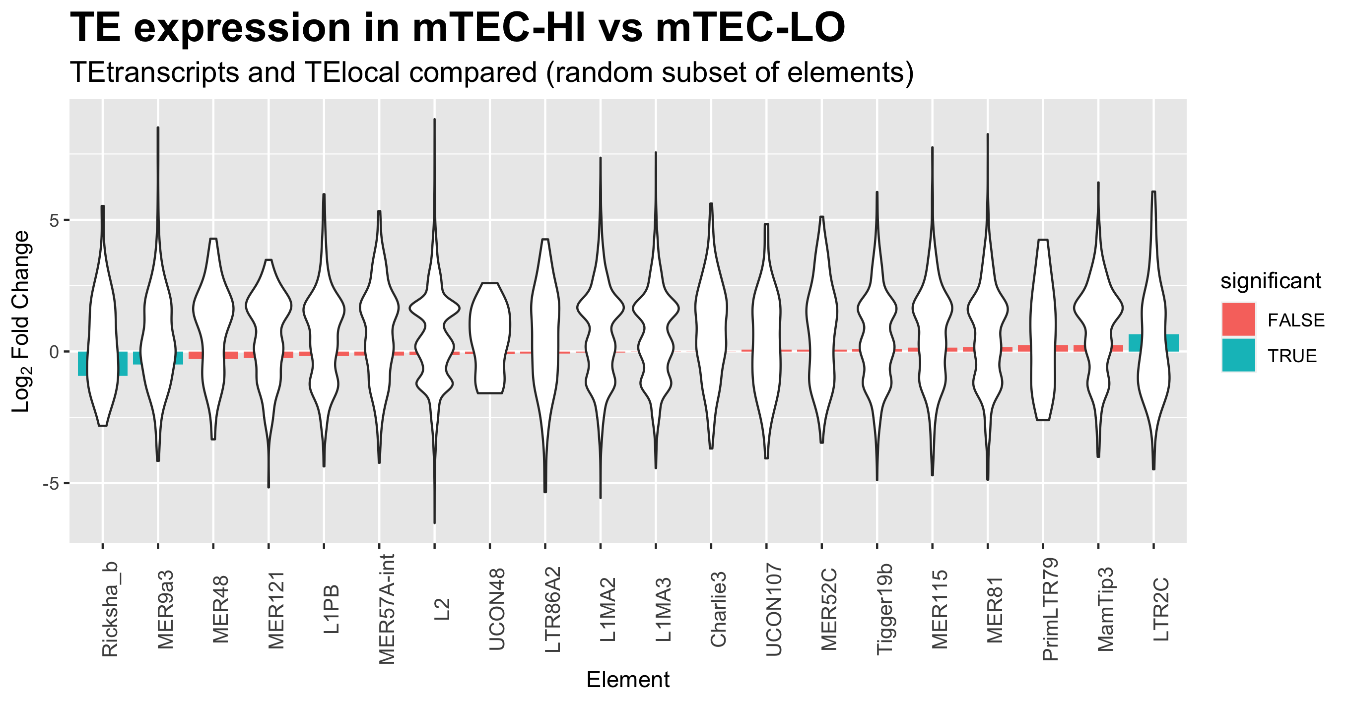

Slide 9
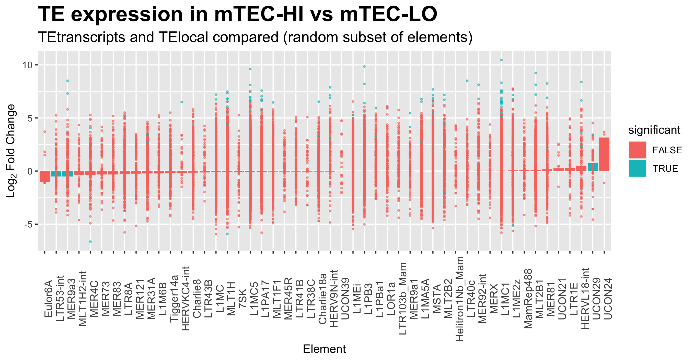

Slide 10
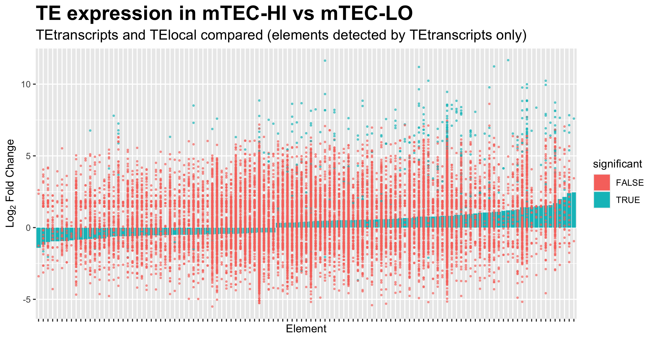

Slide 11
Do differentially expressed TEs tend to overlap with differentially expressed genes?

Slide 12
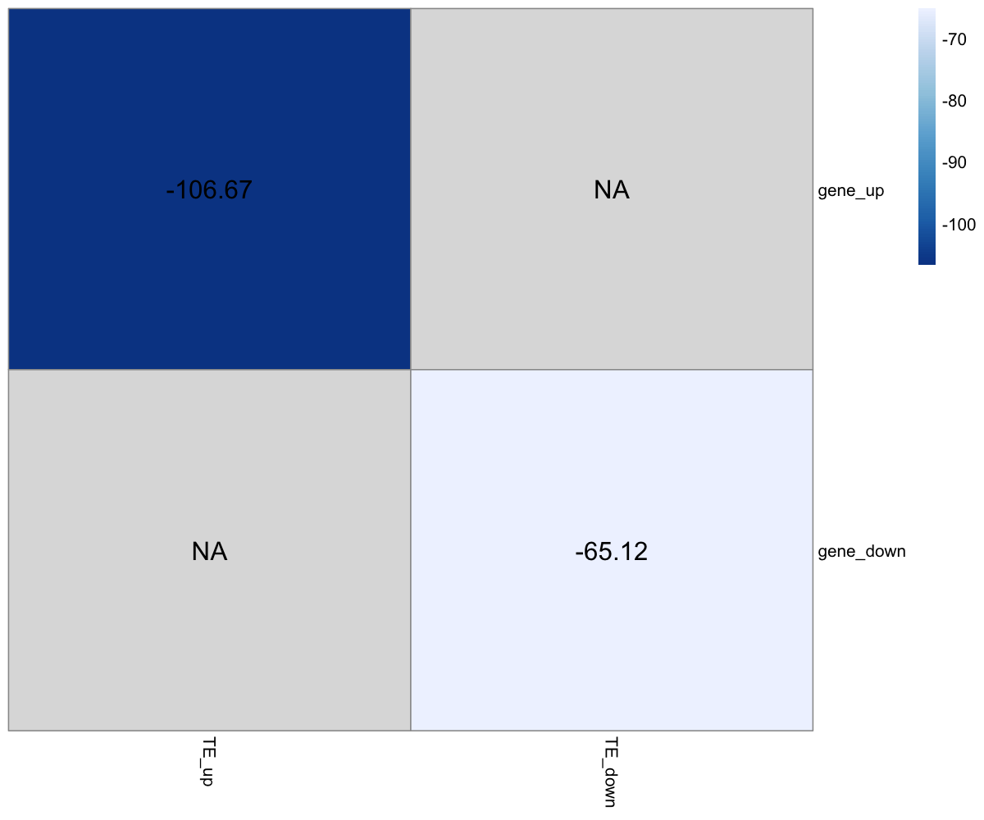
Z-score
Permutations = 1000
Bonferroni-corrected p-values

Slide 13
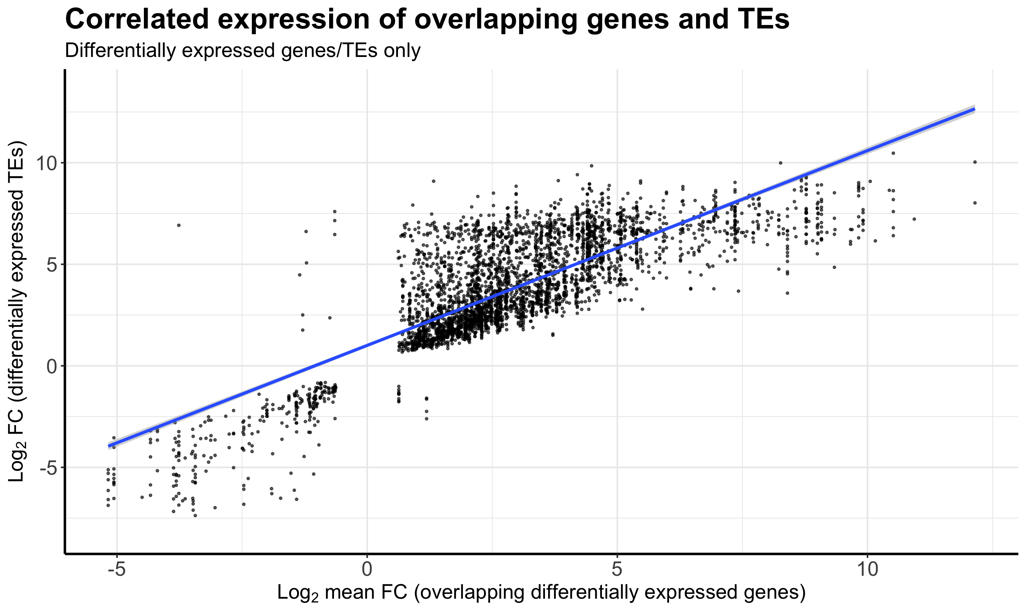
p = 2.2 x 10⁻¹⁶
R² = 0.64
n = 3745
Notes:
For a given TE, can the fold-change in the mTEC-HI vs mTEC-LO conditions be predicted from the mean fold-change of overlapping genes?

Slide 14
